Slide 1


Slide 2

Group and Supervisor
Group Members:
Nasir Shahzad (SP22-BCS-077)
Sohail Faiz Rasool (SP22-BCS-095)
Supervisor:
Mr. Tanveer Ahmad
Institution:
COMSATS University Islamabad

Slide 3

BrainBee: Bridging the Education Divide
An AI-powered learning platform designed to transform education through personalization, gamification, and real-time progress tracking.

Slide 4
Introduction
This project is focused on building an AI-powered educational application that enhances the learning experience for students from Class 5 to 12. The system offers features like AI-generated flashcards, live classes, video lectures, adaptive quizzes, and a dynamic peer battle system. It supports multiple user types, including students, parents, and teachers, each with tailored functionalities. Parents can monitor their children’s progress, assign goals, and view performance analytics. Teachers can manage classes, assignments, and assessments through a dedicated portal. Students can access a personalized learning environment guided by machine learning models. These models include Decision Trees, TF-IDF, IRT, NLP, and Reinforcement Learning for content generation, student assessment, and progress optimization. The app also supports goal-based rewards, collaborative learning, and a full content tracker for health-related statistics. MongoDB is used for efficient and scalable data storage, while media content is managed via Cloudinary. The project aims to deliver an engaging, intelligent, and accessible learning platform tailored to student needs.

Slide 5





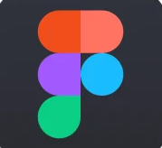
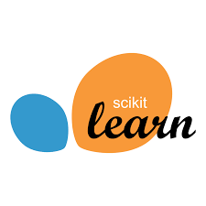


TOOLS AND TECHNOLOGIES

Slide 6

BrainBee Modules
A Smart Learning Platform for Engaging Education

Slide 7
Student: User Management
1
User Accounts
2
Profile Customization
The system creates and manages user accounts for students and teachers.
Students can update their profile details and select subjects.
3
Grade Management
4
Progress Sharing
Teachers manage student grades within the module.
Users can share their learning progress with peers.

Slide 8
Student: Learning
5
AI-Powered Learning Tools
6
Interactive Chatbot Support
Personalized summaries adapt to your learning style. Flashcards are tailored for effective memorization.
Instant doubt clarification is available through the AI chatbot. Just select text for immediate assistance.
7
Comprehensive Class Management
8
Offline Accessibility
Access class materials, discussions, and key details effortlessly. Track grades and performance trends.
Download notes and worksheets for studying on the go. Learn anytime, anywhere, with or without internet access.

Slide 9
Student: Peer Competition
9
Engaging Peer Interaction
10
Enhanced Learning Experience
Promotes friendly competition with AI-generated quizzes and battles.
Students challenge each other with varied topics.
11
Community Features
Enables students to manage friends and track battle stats.

Slide 10
Student: Achievement and Rewards Module
12
Digital Recognition
13
Certificate Management
Students showcase their earned badges on personalized profiles. Achievements unlock as learners master specific educational milestones.
Digital certificates mark significant educational accomplishments. Students can view, download, and share their accolades with peers.
14
Reward Economy
15
Quest Participation
Earned coins create motivation through tangible benefits. Students redeem points for educational resources or special privileges.
Interactive challenges offer additional coin-earning opportunities. Quests encourage exploration beyond standard curriculum requirements.

Slide 11
Student: Performance Analytics Module
16
Comprehensive Score Tracking
17
Detailed Report Cards
Students access their academic progress at a glance. View overall performance metrics and detailed book-by-book analysis.
In-depth performance breakdowns for each educational resource. Identify strengths and areas for improvement with intuitive visual data.
18
Progress Leaderboards
19
Data-Driven Learning
Track performance rankings across multiple timeframes. Compare weekly, monthly, and yearly standings against peers.
Transform performance metrics into actionable insights. Make informed decisions about study habits and focus areas.

Slide 12
Student: AI Powered Assistant Module
20
Smart Academic Support
21
Continuous Learning
Our AI assistant provides instant answers to student questions. The model is trained specifically on course materials for accurate guidance.
The assistant improves with each interaction. It adapts to students' learning styles and common question patterns.
22
Conversation History
23
24/7 Availability
All chats are saved for future reference. Students can revisit previous explanations when studying for exams.
Learning happens anytime, so our AI assistant never sleeps. Get help with difficult concepts even outside school hours.

Slide 13
Parent Application

Slide 14
Parent: Monitor Children Module
1
Child Management
2
Academic Progress
Parents can easily add or remove children from their account. Track multiple students from a single dashboard.
Access detailed report cards for each book. View subject-specific performance metrics and completion rates.
3
Activity Tracking
4
Performance Reports
Monitor learning engagement in real-time. See time spent on different subjects and completed exercises.
Receive comprehensive weekly and monthly summaries. Get instant notifications when goals and quizzes are completed.

Slide 15
Parent: Goals Module
5
Goal Management
6
Progress Tracking
Parents can create, modify, and remove personalized academic goals for their children. Goals can be customized based on subjects or specific skills.
Real-time monitoring of children's advancement toward established goals. Visual progress indicators help both parents and children stay motivated.
7
Reward System
8
Achievement Timeline
Parents assign digital coins for completed goals. These rewards encourage continuous learning and achievement through positive reinforcement.
View history of completed goals and earned rewards. Celebrate learning milestones to build confidence and persistence.

Slide 16
Teacher Application

Slide 17
Teacher: Class Management Module
1
Classroom Organization
2
Content Management
Create multiple virtual classrooms with intuitive controls. Add or remove students with simple drag-and-drop functionality.
Upload and organize learning materials by subject or topic. Modify existing resources to keep content fresh and relevant.
3
Assessment Tools
4
Collaborative Features
Build customized quizzes using our template library. Create and distribute assignments with automatic grading capabilities.
Engage in classroom discussions through integrated messaging. Foster peer learning in a secure digital environment.

Slide 18
Teacher: Assessment Module
5
Performance Monitoring
6
AI-Powered Insights
Track individual student progress across all assignments and quizzes. View completion rates and identify learning gaps instantly.
Machine learning algorithms analyze student data to generate personalized reports. Receive actionable recommendations for each student's unique learning journey.
7
Custom Learning Paths
8
Real-Time Feedback
Design tailored educational experiences based on performance data. Adjust difficulty levels and content to match each student's abilities.
Identify struggling students before they fall behind. Intervene quickly with targeted support exactly when needed.

Slide 19
Software Design Methodology
The design methodology been followed for BrainBee is Object-Oriented Programming (OOP). OOP has several advantages discussed below,
Modularity: Each feature (Flashcards, Battles, AI Quiz Generator) is a separate component that can be developed and tested independently.
Reusability: Common functionality (like user authentication) is shared across different user classes, reducing code duplication.
Maintainability: Easy to add or update features, such as new user roles or learning modules, without affecting the whole system.
Scalability: Supports growth as BrainBee adds more modules or users.
Clear Structure: Makes it easier for team members to understand, collaborate, and extend the system.

Slide 20
Software Design Process
Iterative Development: Allows us to break the project into small sprints (2–3 weeks), each delivering a functional part of the system.
Early Feedback: Frequent reviews and feedback from our supervisor help us ensure the application stays aligned with user needs.
Modular Scope: Since the app has multiple independent modules (e.g., flashcards, battles, live classes), they can be developed and tested in parallel.
Adaptability: If priorities change or new challenges arise, Agile allows for quick adaptations without reworking the whole system.
Team Collaboration: Encourages teamwork and clear communication between frontend, backend, and ML developers.

Slide 21
Architecture Diagram

Slide 22
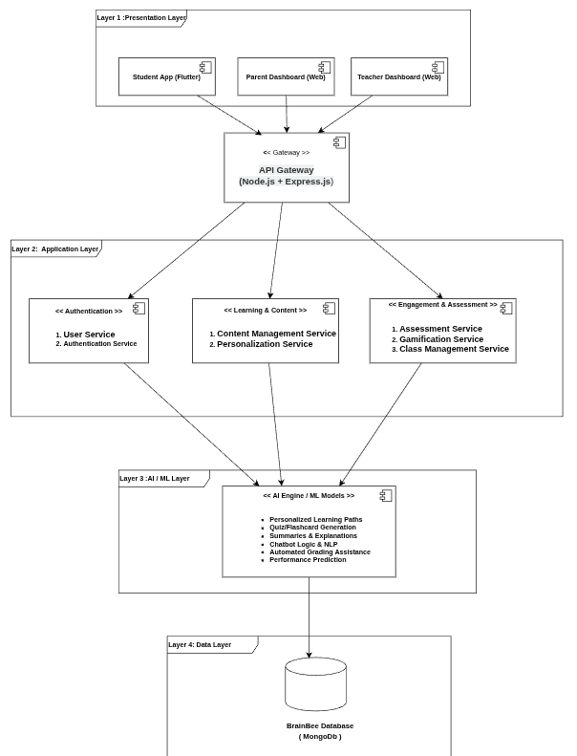

Slide 23
Activity Diagrams

Slide 24
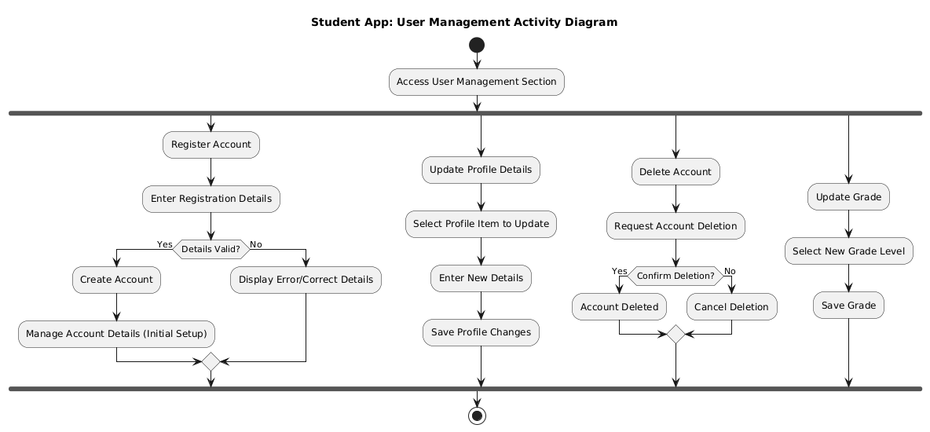

Slide 25
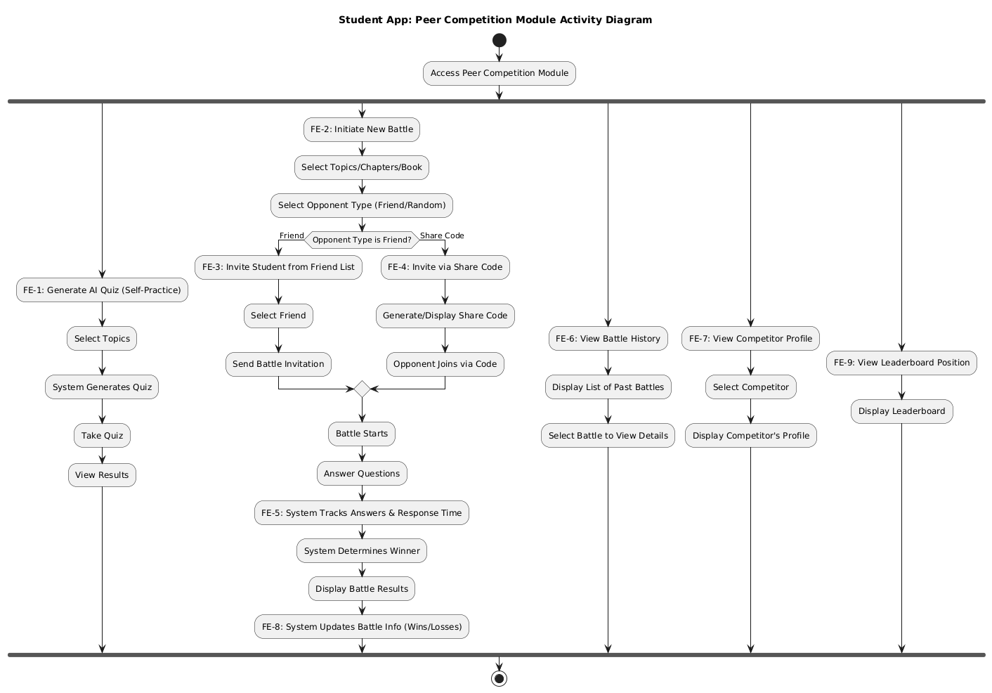

Slide 26
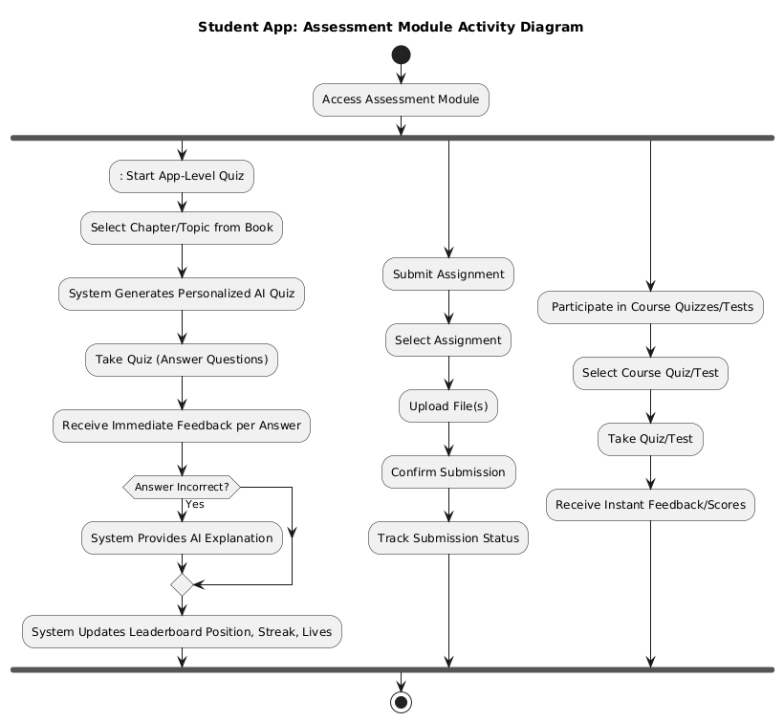

Slide 27
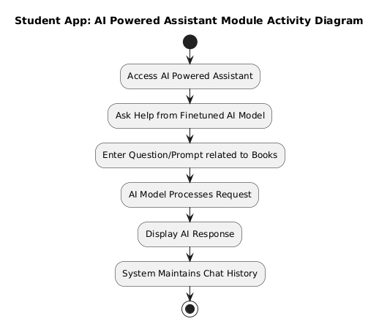

Slide 28
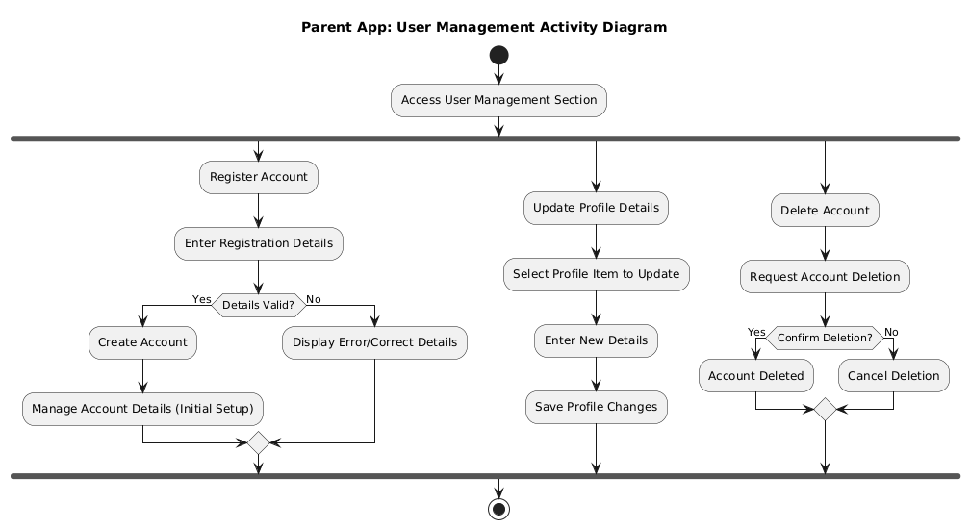

Slide 29
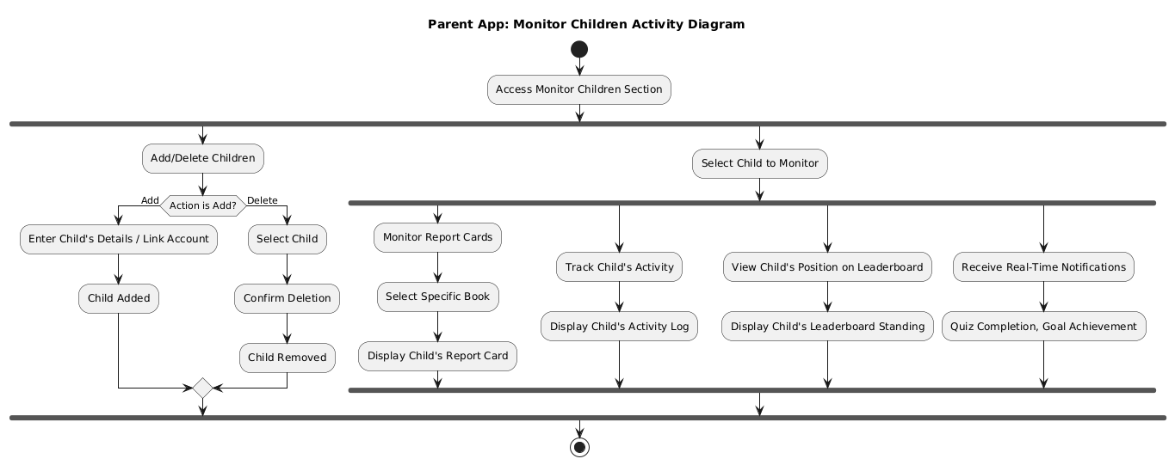

Slide 30
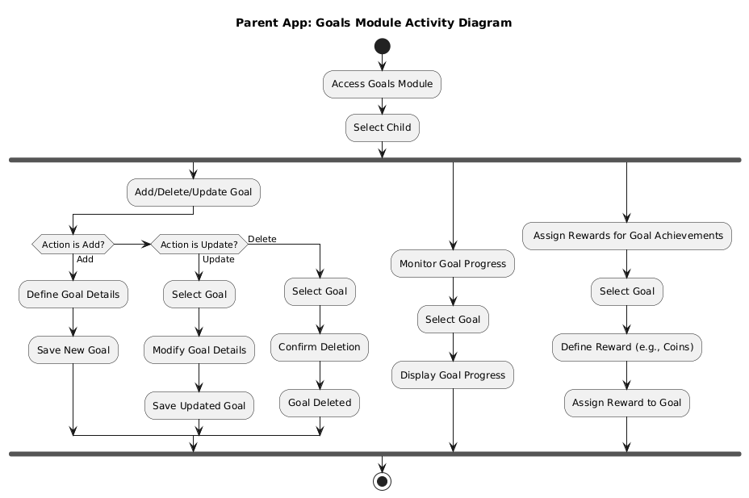

Slide 31


Slide 32
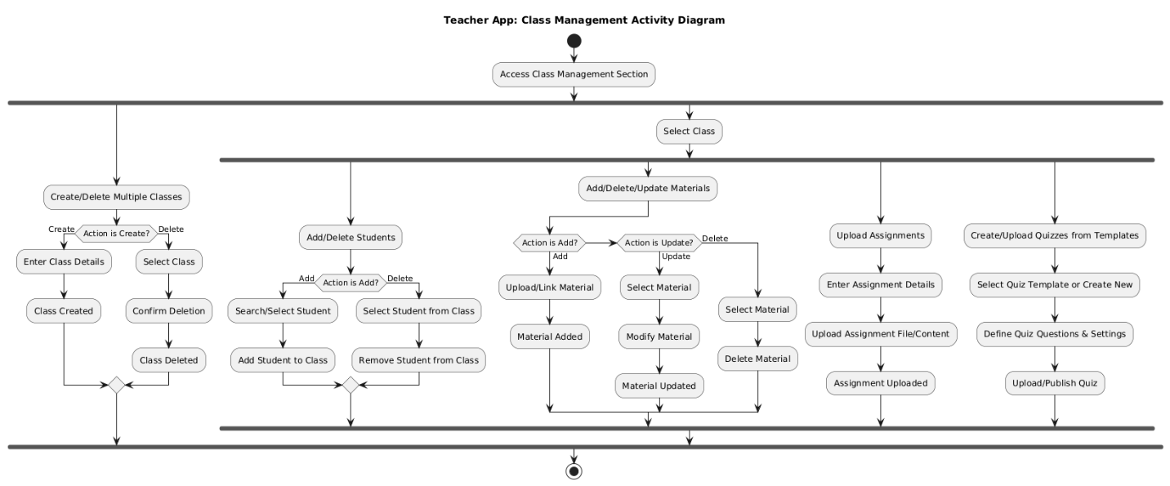

Slide 34
Class Diagram

Slide 35
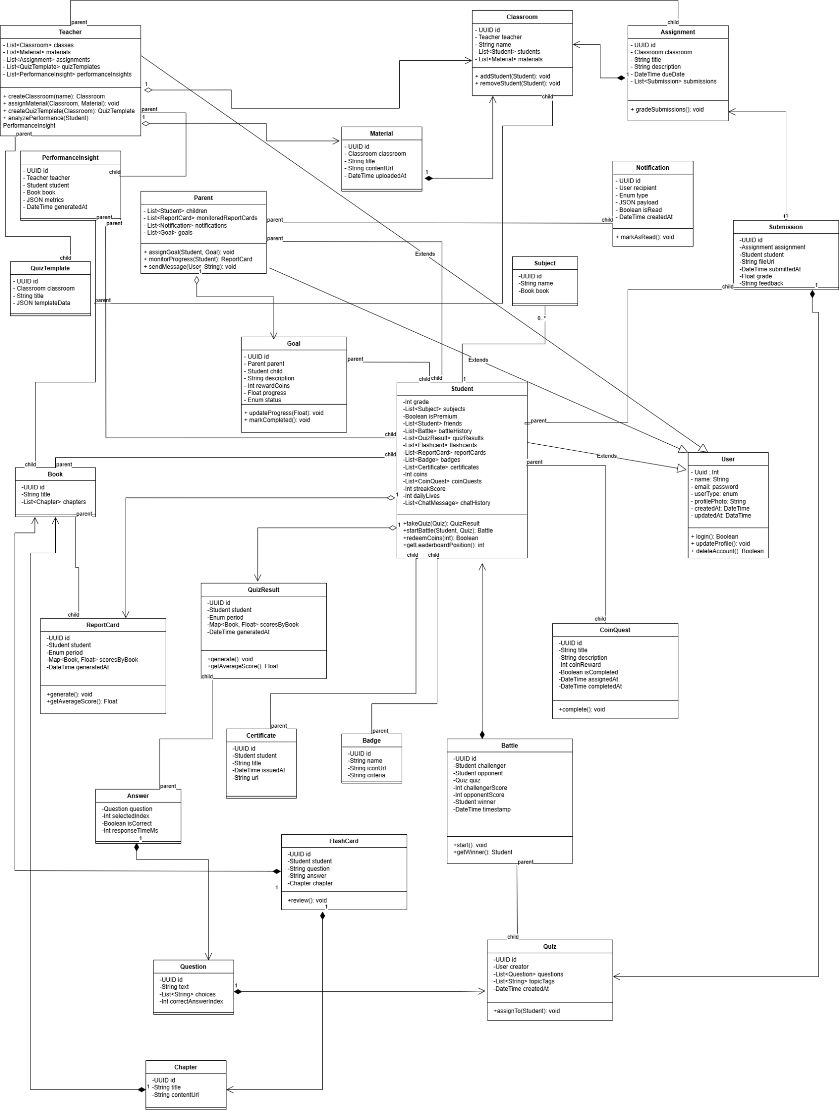

Slide 36
Sequence Diagrams

Slide 37
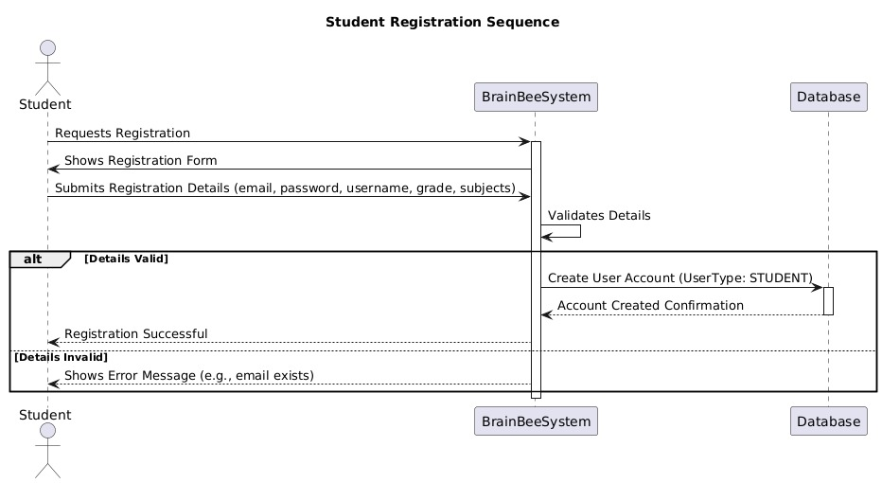

Slide 38
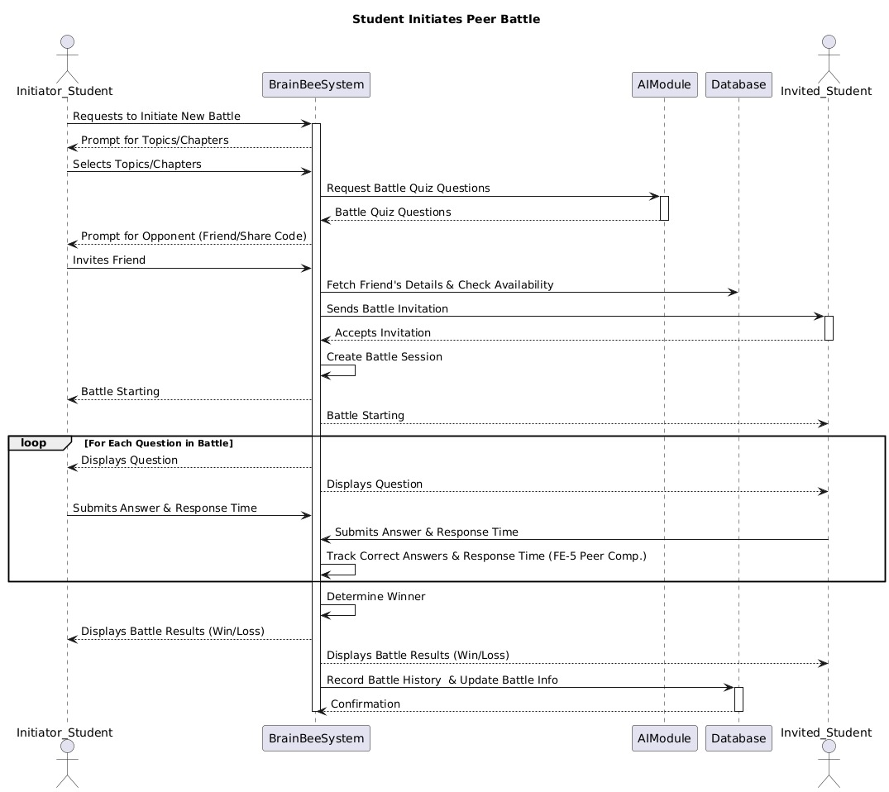

Slide 39
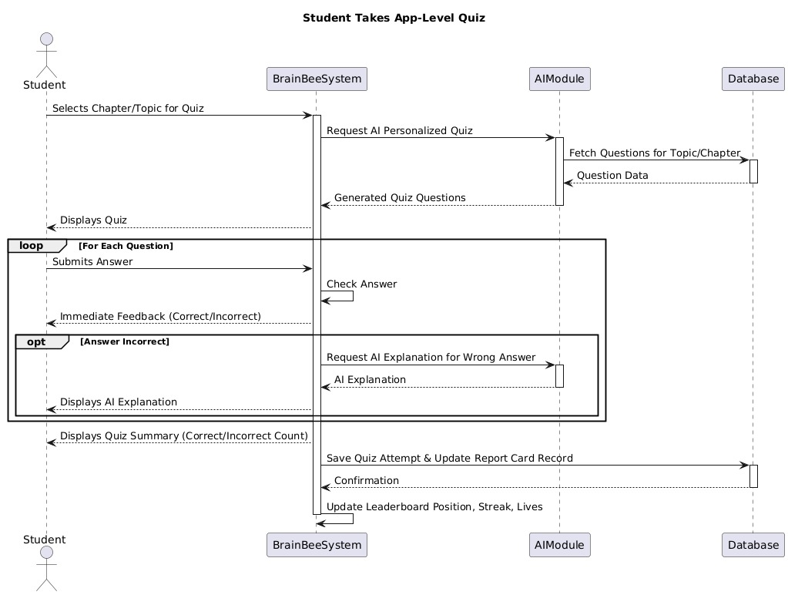

Slide 40
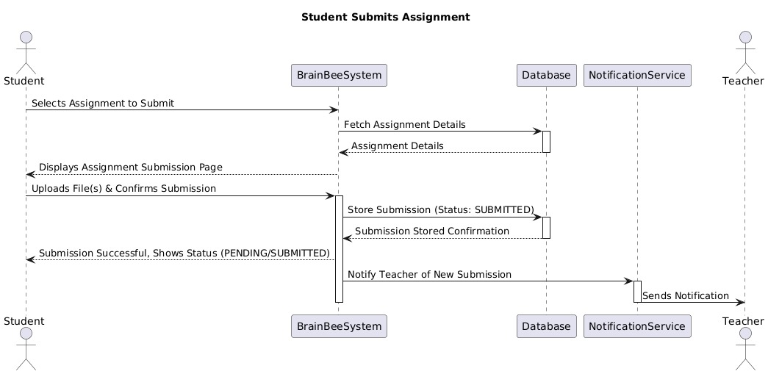

Slide 41
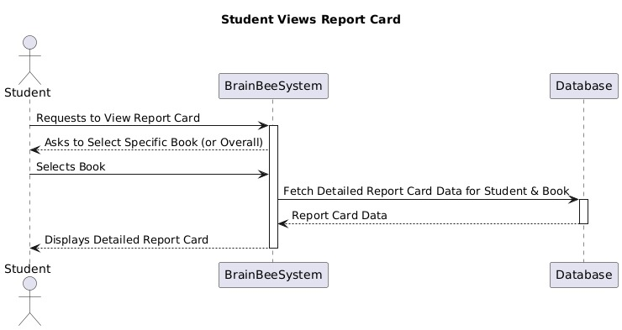

Slide 42
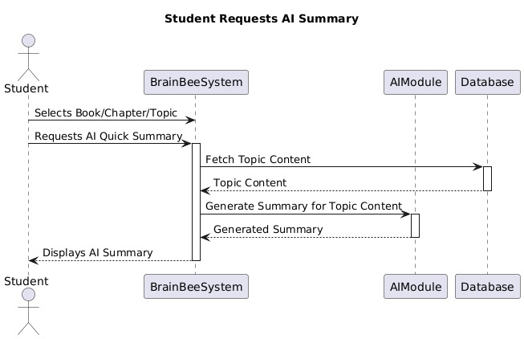

Slide 43
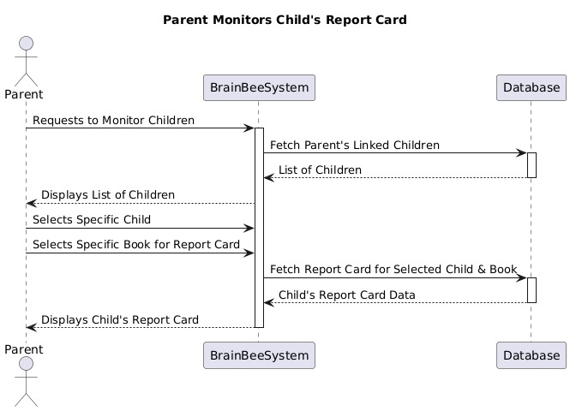

Slide 44
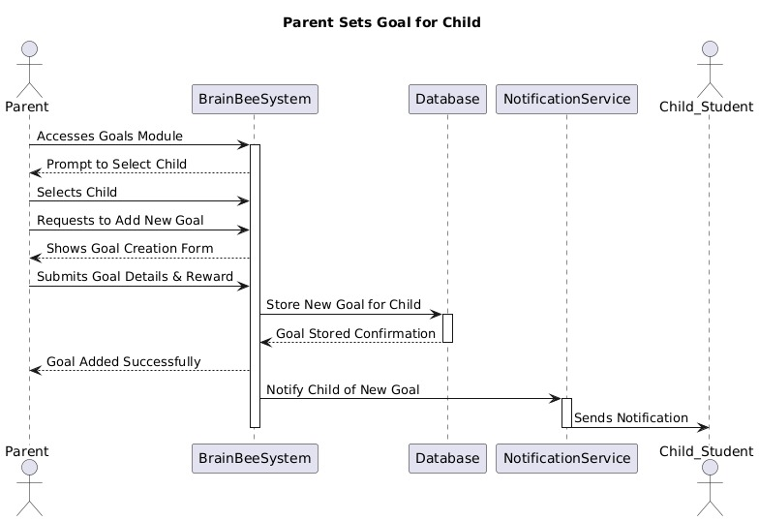

Slide 45
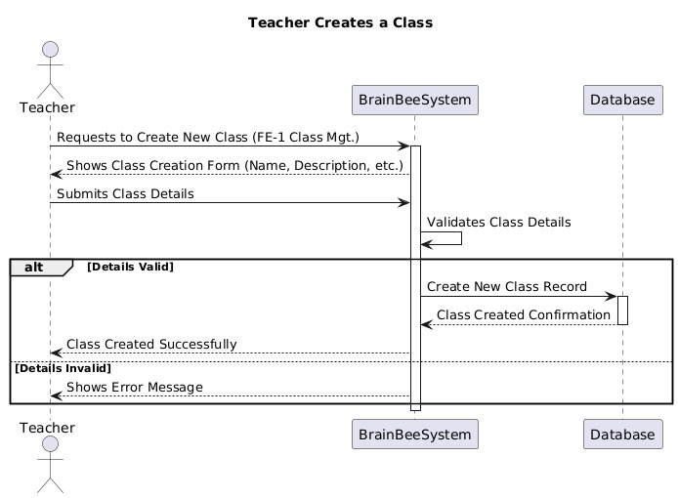

Slide 46
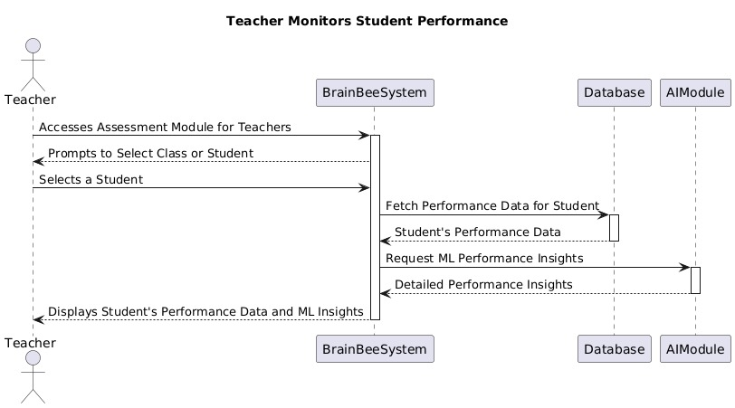

Slide 47
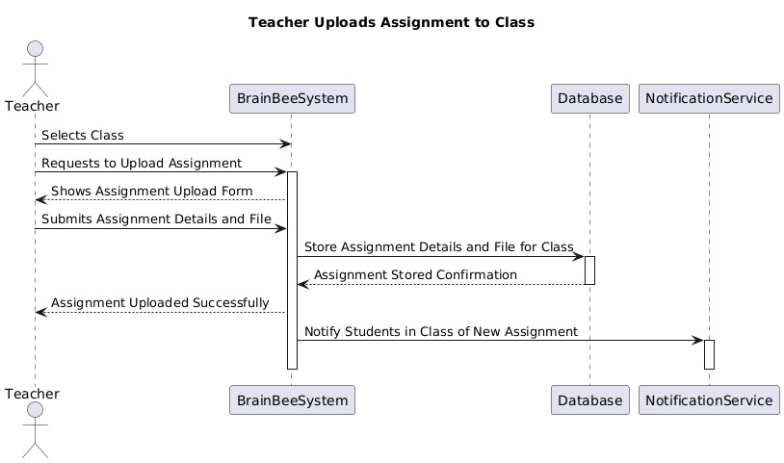

Slide 48
State Transition Diagrams

Slide 49
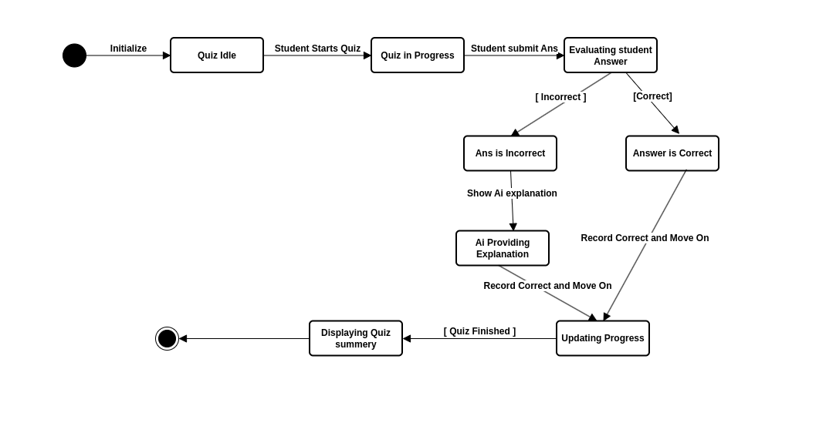
State Transition Diagram for Quiz

Slide 50
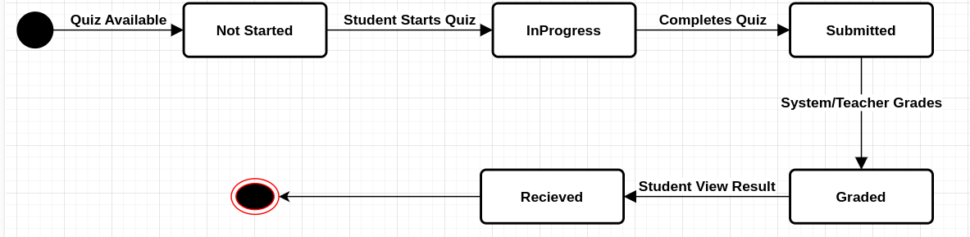
State Transition Diagram for Quiz Attempt

Slide 51
Interfaces

Slide 52
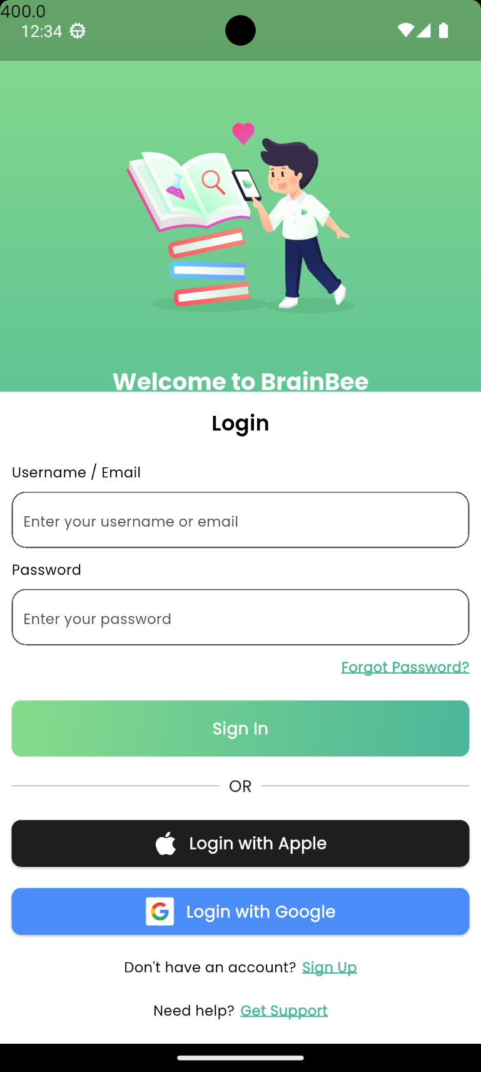
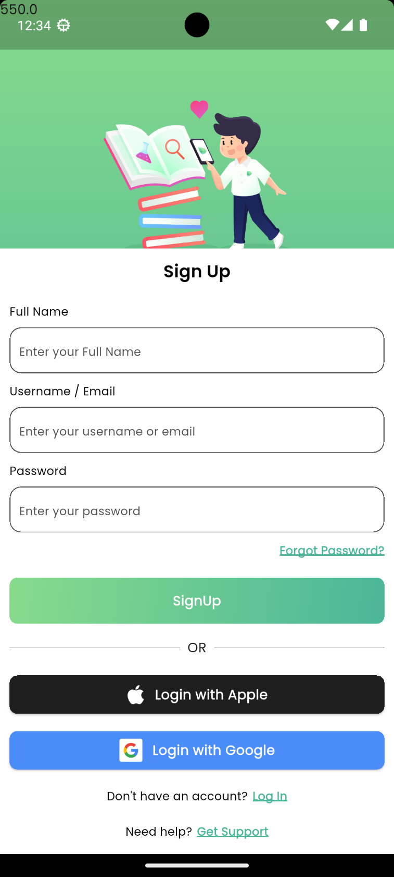
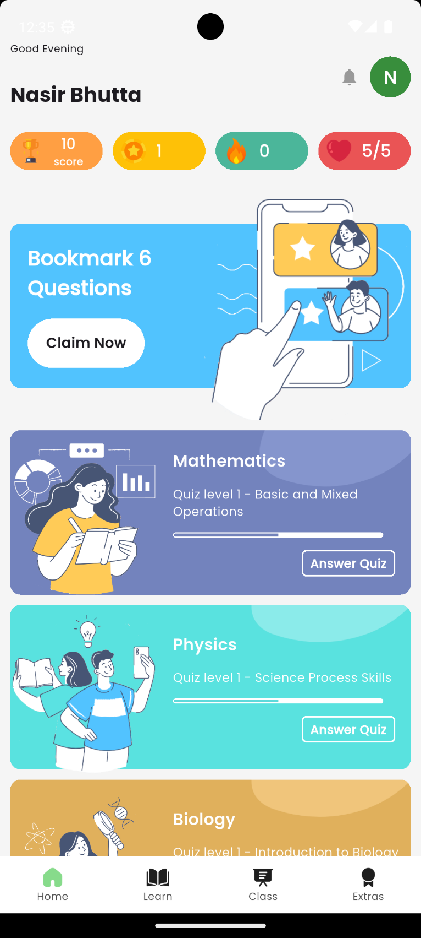
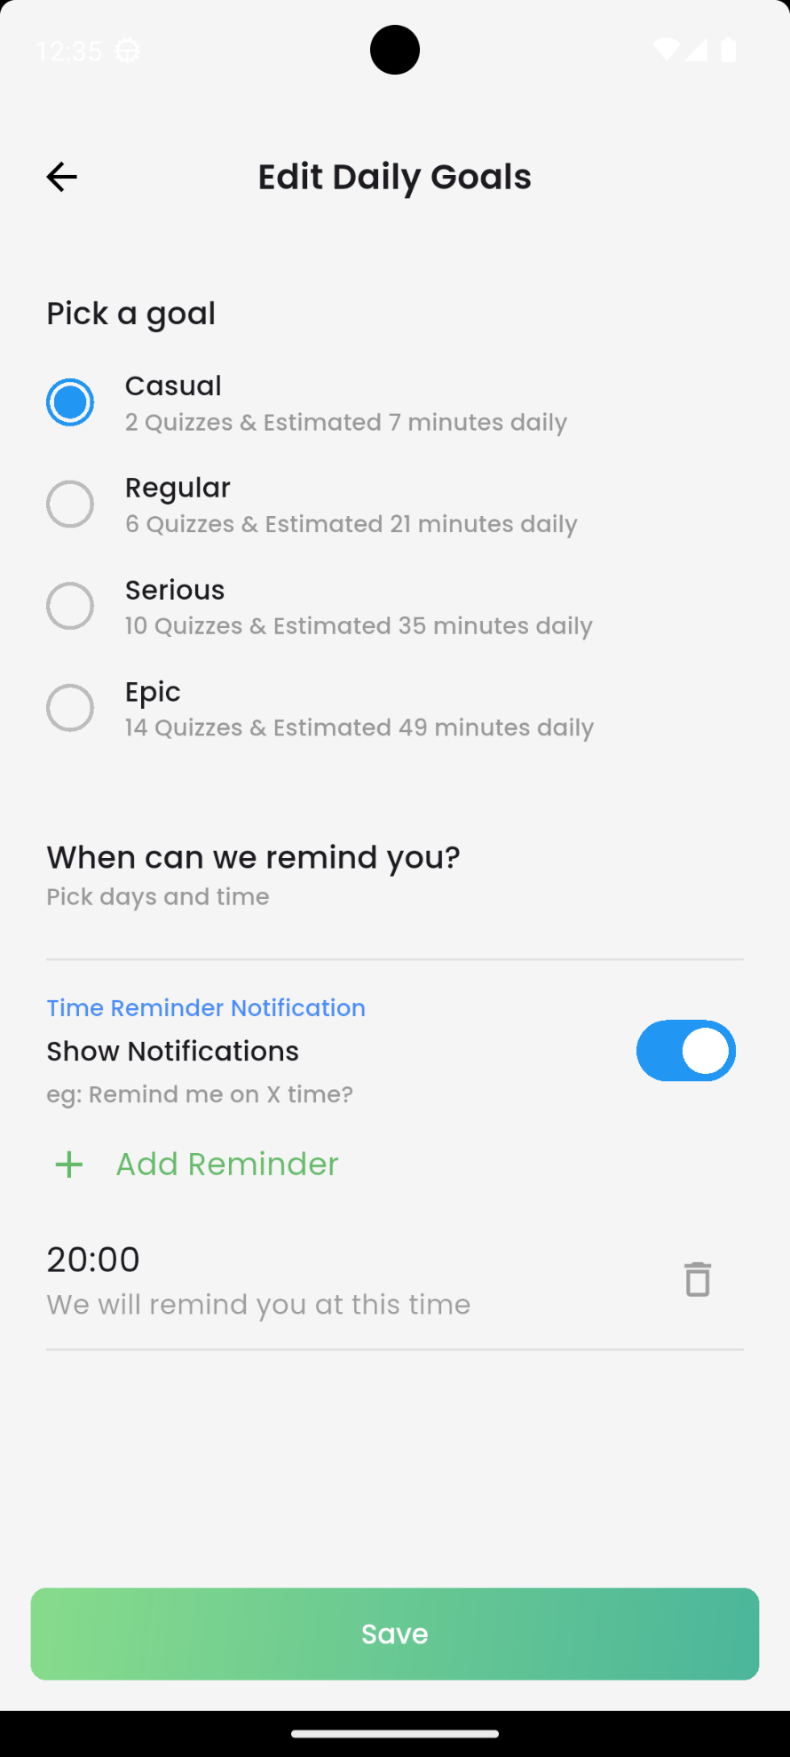

Slide 53
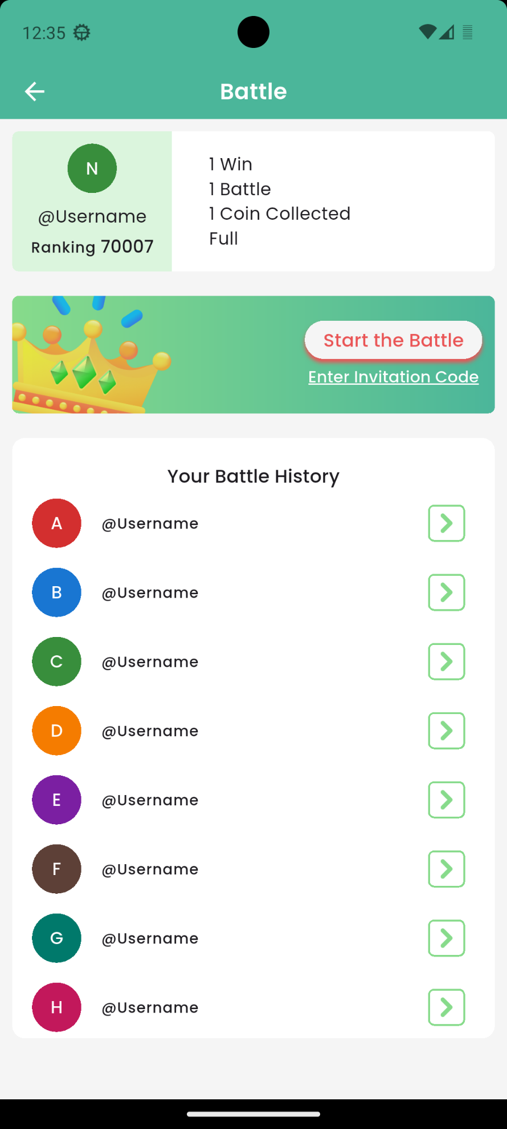
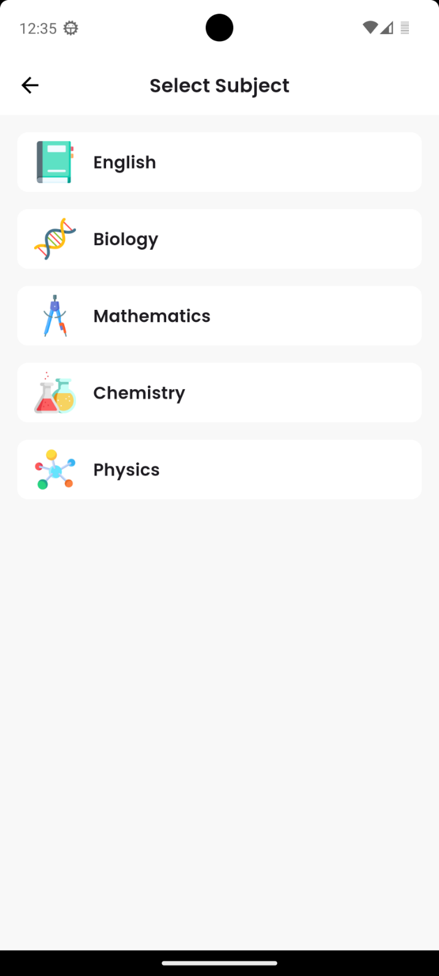
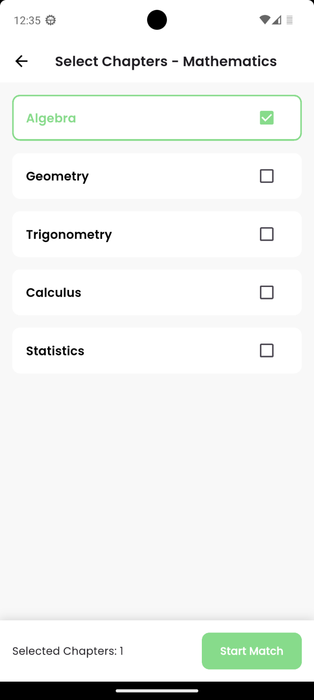
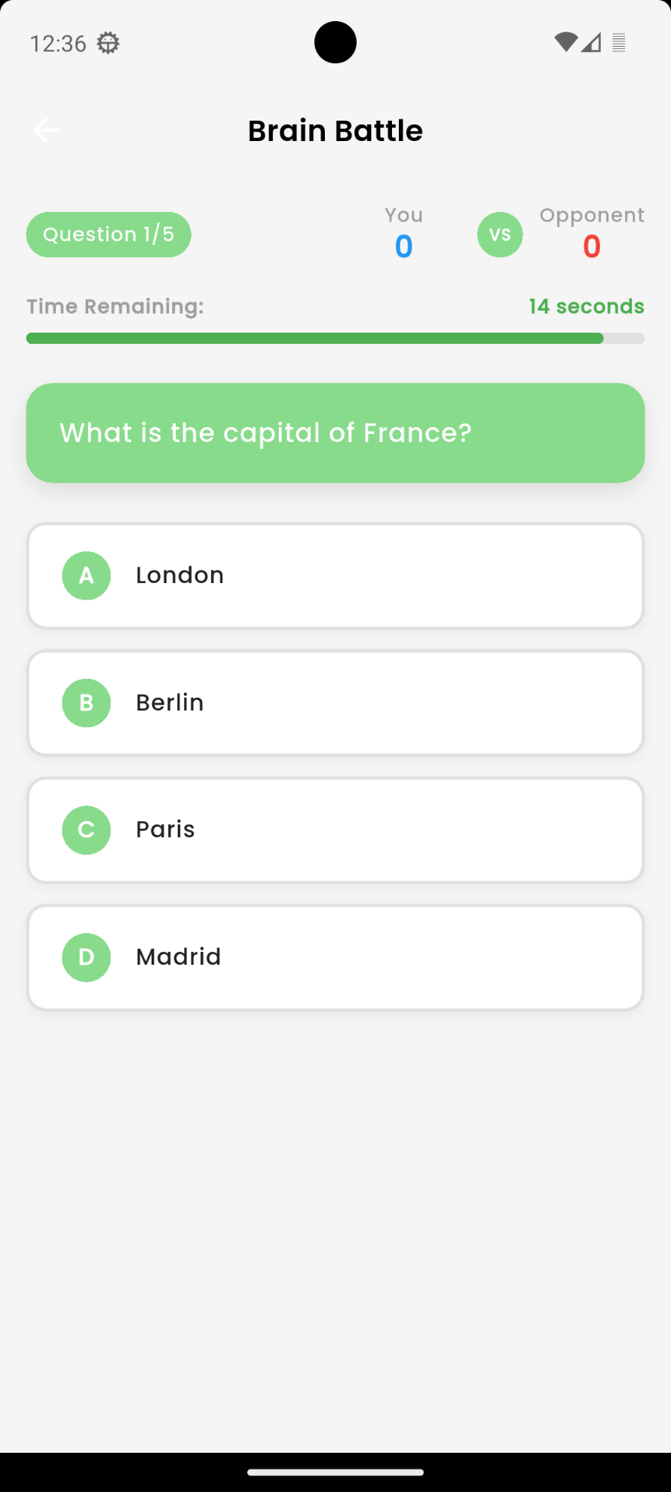

Slide 54
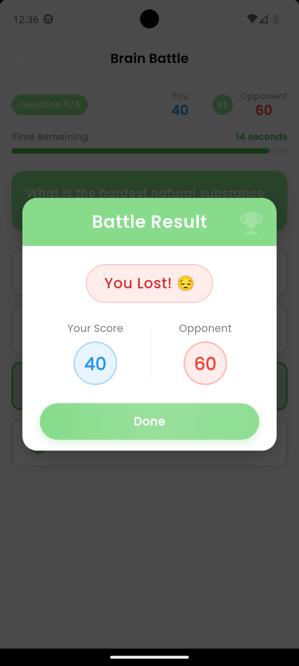
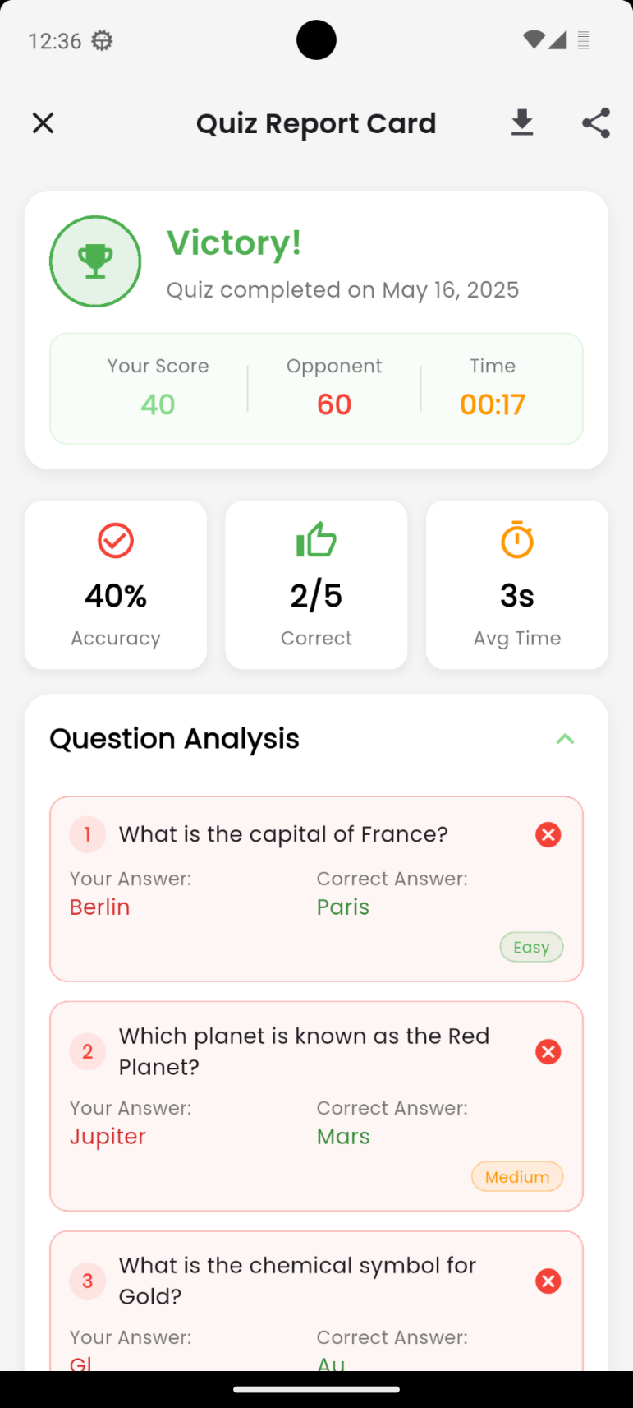
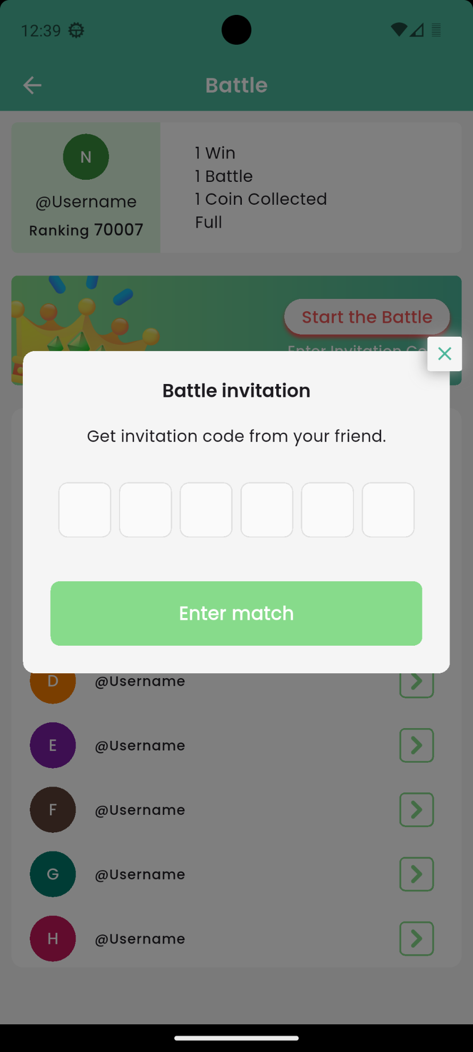
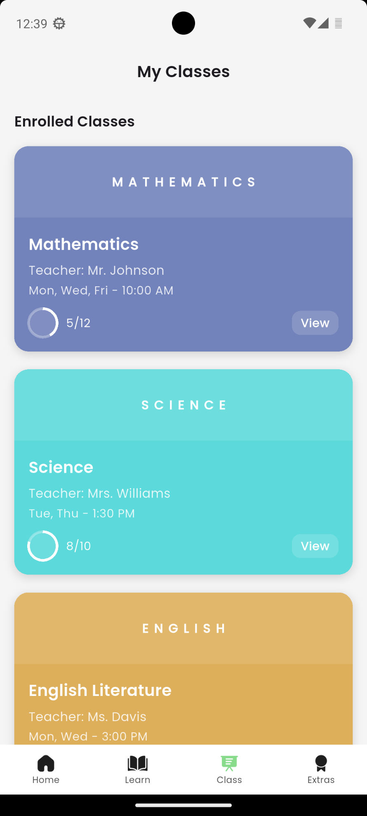

Slide 55
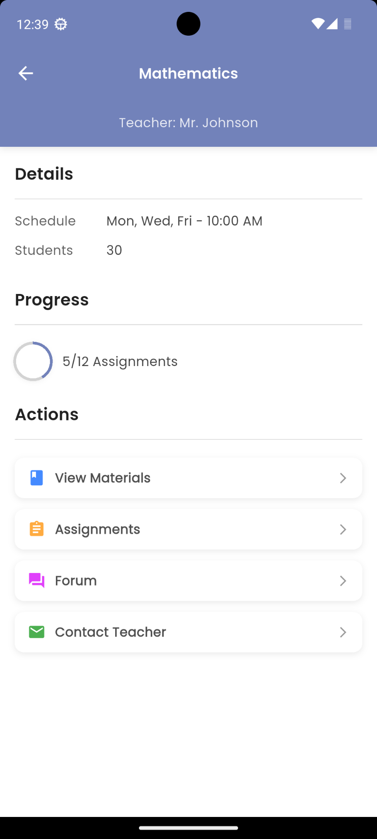
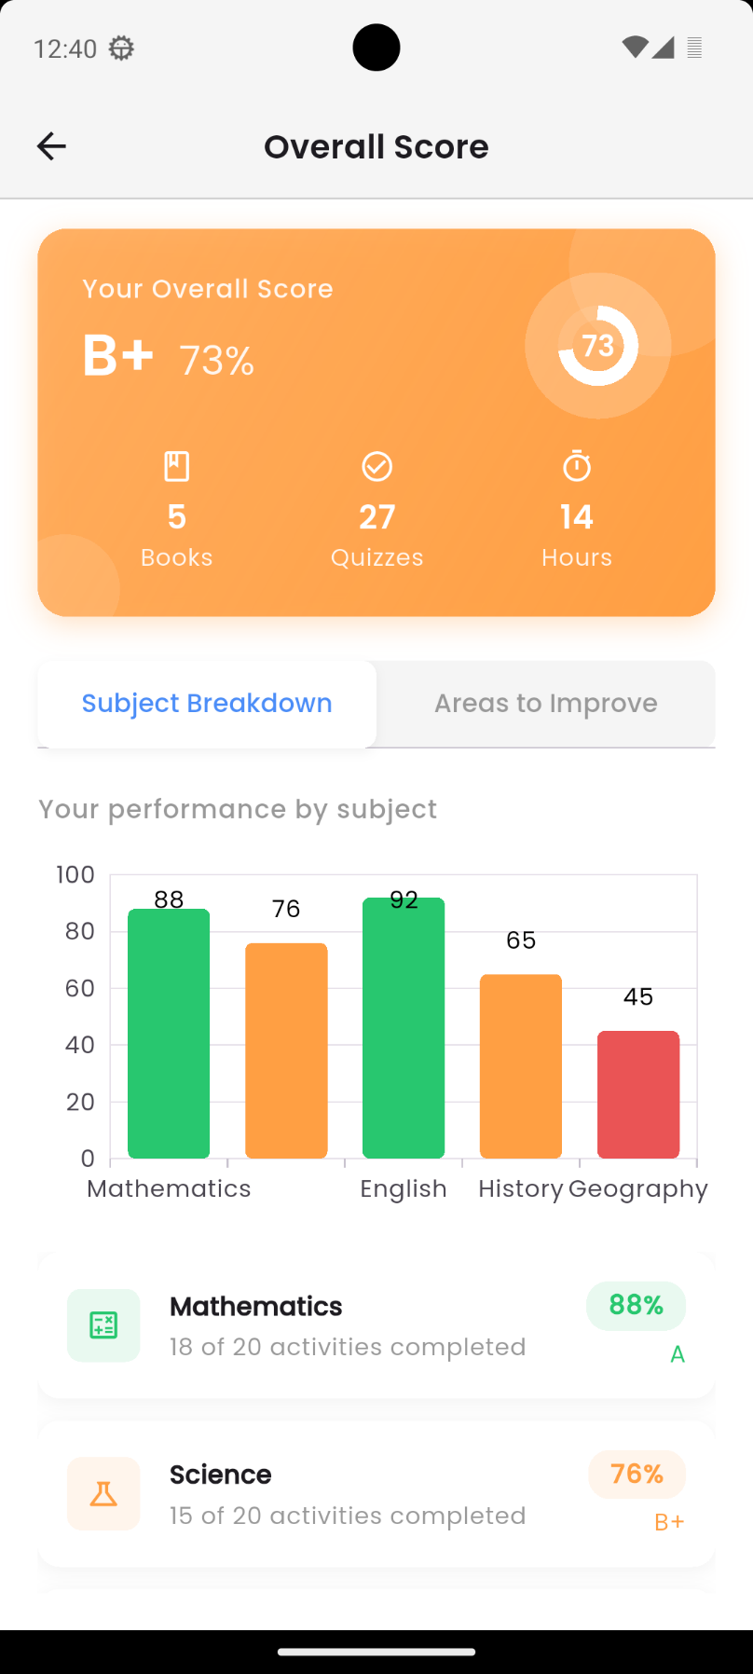
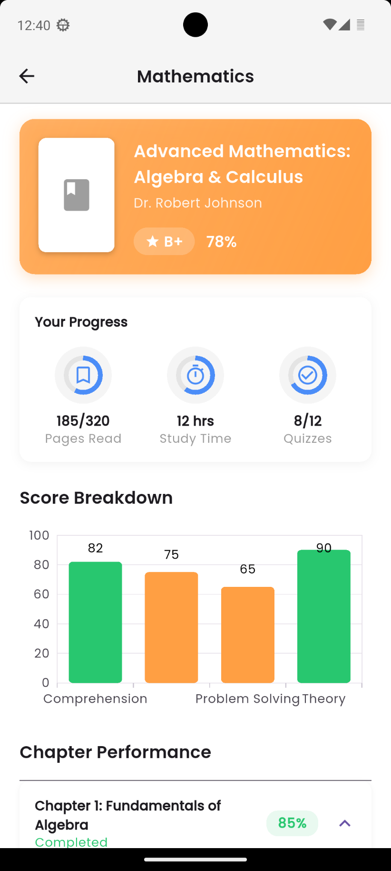
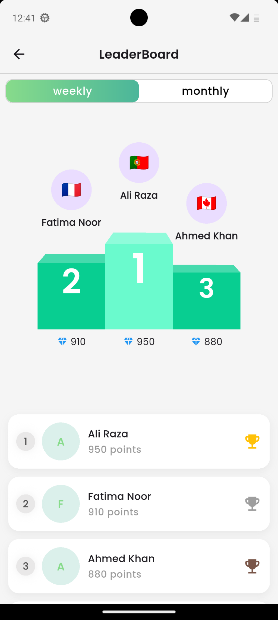

Slide 56
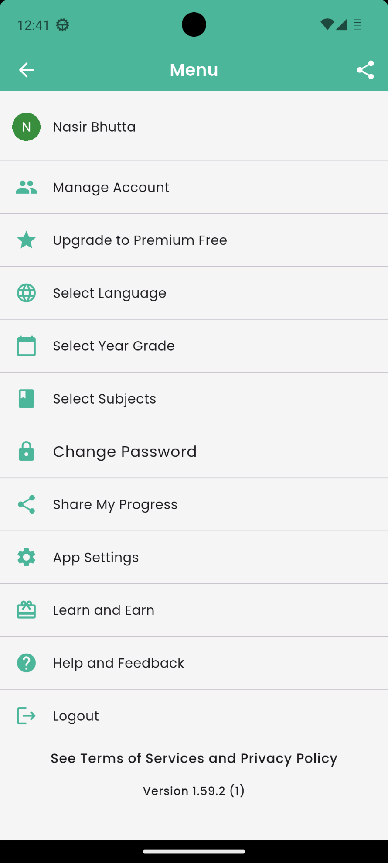
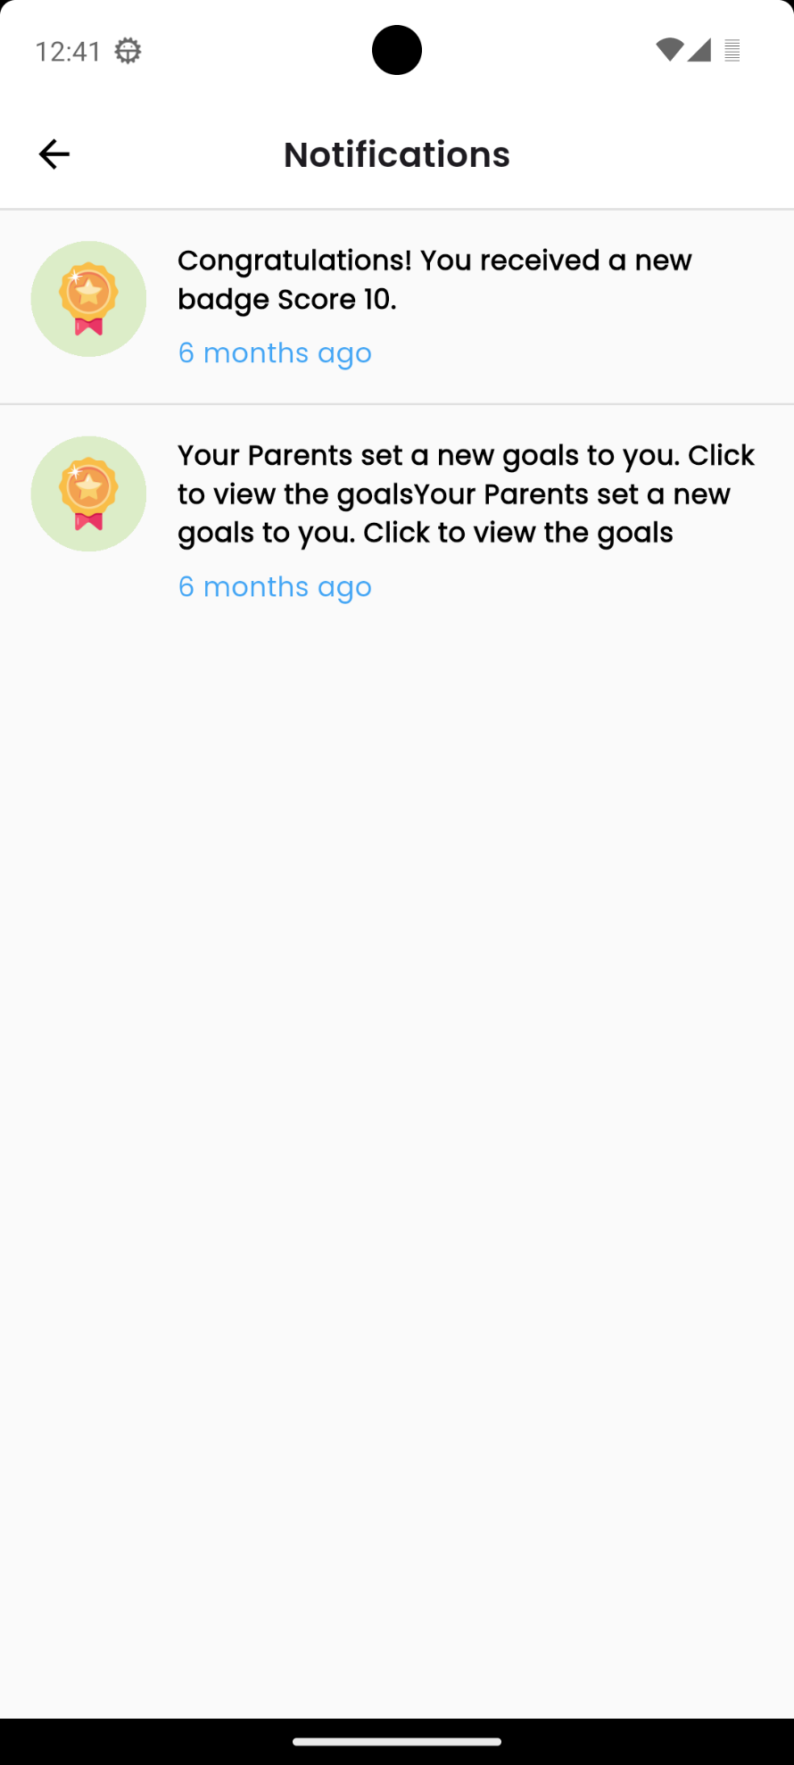

Slide 57
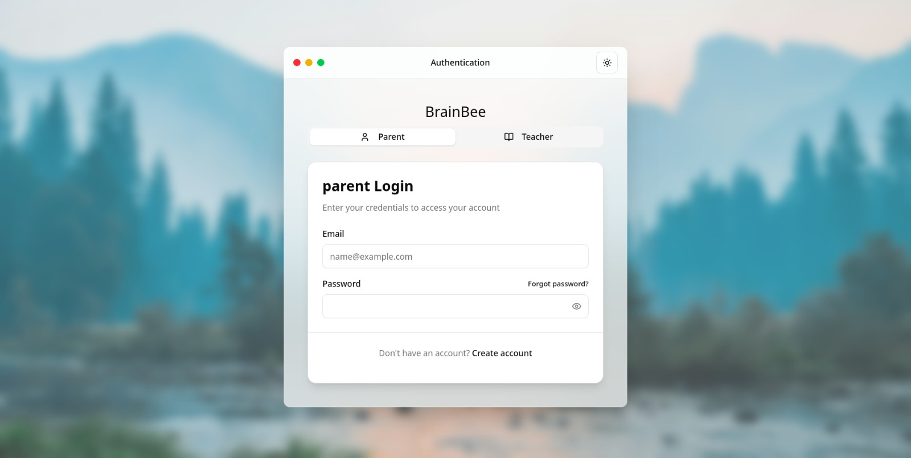

Slide 58
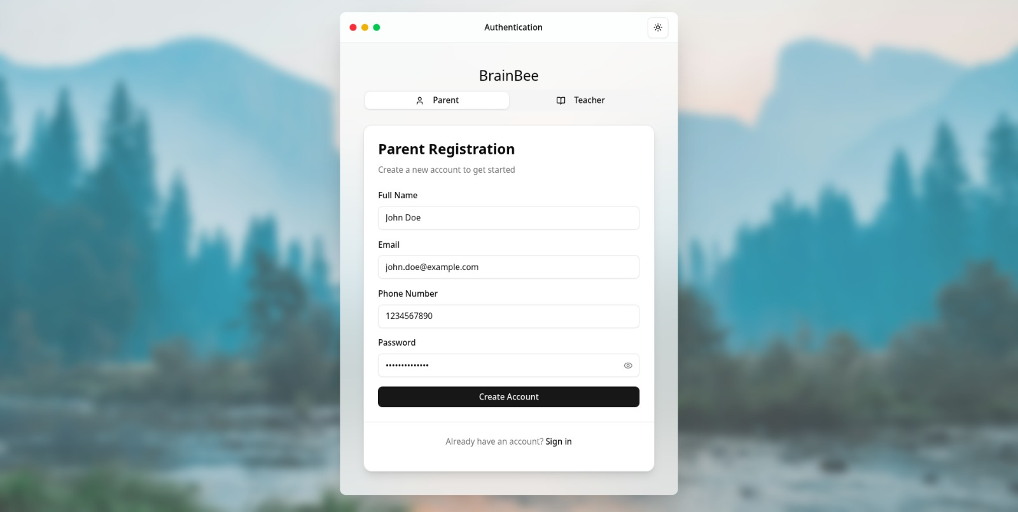

Slide 59
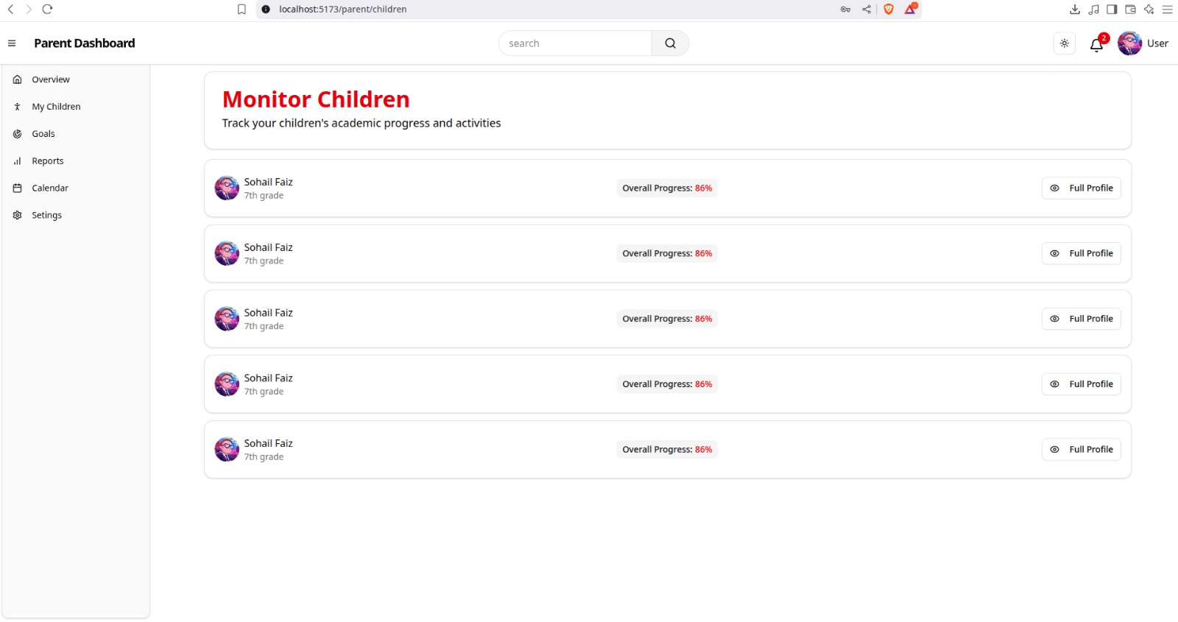

Slide 60
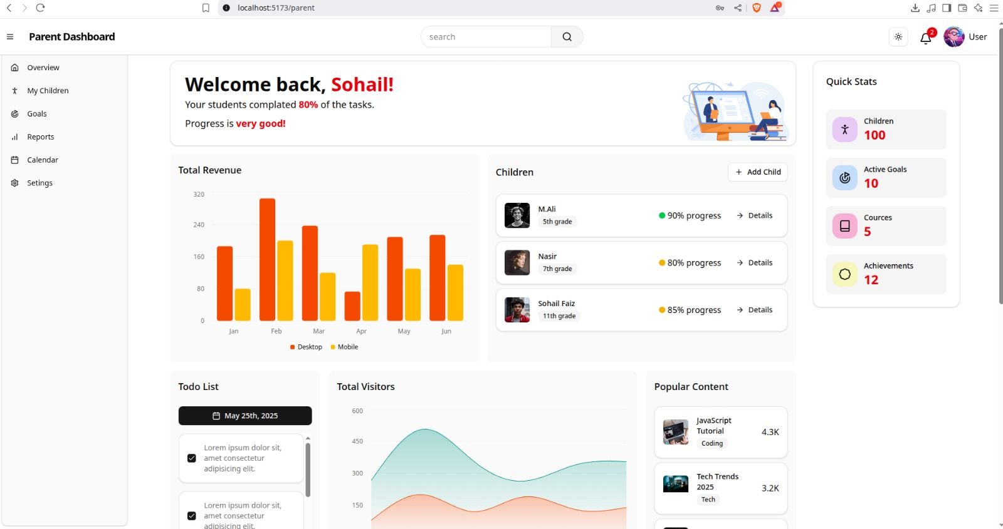

Slide 62
COnclusion

Slide 63
BrainBee is an AI-powered educational platform focused on personalized learning for students from Class 5 to 12.
It simplifies learning through features like AI-generated flashcards, adaptive quizzes, peer battles, and parent/teacher monitoring.
The system is built using a Modular + MVC Software Design Methodology and follows the Agile process for iterative development.
Technologies used include MongoDB, Cloudinary, Firebase, and ML libraries like scikit-learn, spaCy, and Hugging Face.
All major diagrams — Architectural, Activity, Sequence, Class, and State Transition Diagrams — are included to depict system flow and behavior.
State Transition Diagrams clearly explain how users move between different app states like login, learning, testing, reviewing, and tracking progress.
BrainBee offers a smart, interactive, and scalable solution to modern education by merging AI with meaningful user experience.

Slide 64
THANK YOU!

